Slide 1




CIS3187 (5 ECTS) Coursework Coursework 2022-23
John Abela
Department of CIS
Faculty of ICT
University of Malta
john.abela@um.edu.mt
+ 365 79367936
Room 1A/27
FICT Building
©John Abela 2018-2022
Faculty of
ICT
Department of
Computer Information Systems
Last Updated
02-Nov-2022

Slide 2




CIS 3187 Coursework Implementing a Multi-Layer Perceptron
Coursework
2022-23
Important Note!
Students taking CIS3087 are advised that, although they do not have to implement a multi-layer perceptron in code, they have to understand how error back propagation works.
There is always at least one question on neural networks in the CIS 3087 & the CIS 3187 exams.
It is therefore probably not wise to not pay attention to the lectures on neural networks.
Not paying attention
ICT

Slide 3


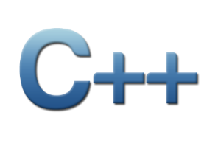







CIS 3187 Coursework Deliverables (1) Implementing a Multi-Layer Perceptron
Coursework
2022-23
The objective of this assignment is to learn how artificial neural networks work and how to implement a multi-layer perceptron in a high-level language trained using the error back propagation algorithm.
Implement an artificial neural network that learns classify which passengers on the Titanic survived or not from their demographic and other attributes.
You must randomly choose 80% of the data for training and 20% for testing.
The neural network must have 5 input neurons, 4 hidden neurons, and 1 output neuron. Use the Sigmoid transfer function, 0.2 error threshold and 0.2 learning rate.
You are encouraged to experiment with more hidden neurons.
Implement the Error Back Propagation algorithm for training the weights.
You must use a high-level language such as C++, C, Java, C#, Swift, Objective-C, Go, Python, Rust, or Scala.
ICT

Slide 4
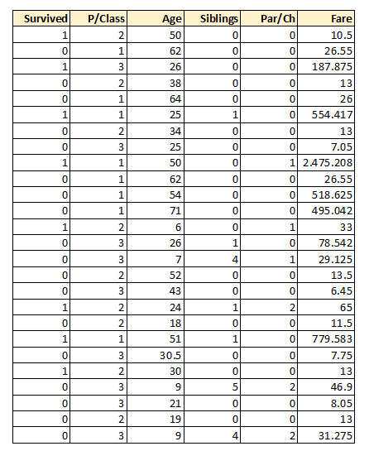
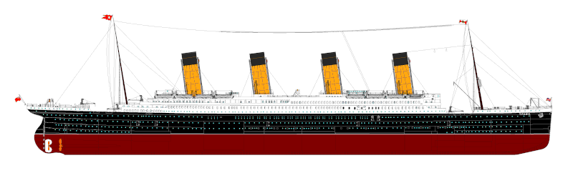
CIS 3187 Coursework Deliverables (1) Implementing a Multi-Layer Perceptron
Coursework
2022-23
The datasets has already been cleaned up and missing values removed.
Survived – 0 or 1. This is the Target (Label).
P.Class – Passenger Class
Age
Siblings – no of siblings
Par/Ch – parents or children of passenger.
Fare – price paid in US$ (you may want to normalize this).
ICT

Slide 5





CIS 3187 Coursework Deliverables (2) Implementing a Multi-Layer Perceptron
Coursework
2022-23
You may not use Python AI or Machine Learning packages. The implementation must be your own. You can, however, use matrix/vector arithmetic packages such as NumPy or Pandas.
You must plot the bad facts vs the epochs graph to show convergence.
You can use RapidMiner (instead of writing and implementing your own neural network) but the marking will then be out of 50%.
Documentation must include source code, data sets, epochs graph, problems encountered, choices made, testing results, plus any comments you wish to make.
The network should typically converge in less than 1000 epochs but convergence is not guaranteed.
ICT

Slide 6
Submission Deadline and Notes
Deadline is Friday 20th January 2022 at Midnight.
Do not forget the Plagiarism Declaration Form which must be signed.
Do not forget a Statement of Completion.
You must also upload the coursework, as a single Word or PDF file to Turnitin on the VLE. You must include all the code in this document.
Put a soft copy of the document, all code, data, and binaries in a ZIP, RAR, or 7z file and upload to the designated area on the VLE.
All submissions are to the VLE only. You do not have to print anything (except the Plagiarism Declaration).
Drawings and images in the documentation are encouraged. Font must be Calibri 11pt.
You can quote other work as long as this is clearly indicated.
If you use images from 3rd parties simply caption with ‘reproduced from…’
Make sure you include your full name, ID or passport number, and the degree programme.
You may work in groups as long as the work you submit is your own and only your own.
Coursework
2022-23
ICT

Slide 7
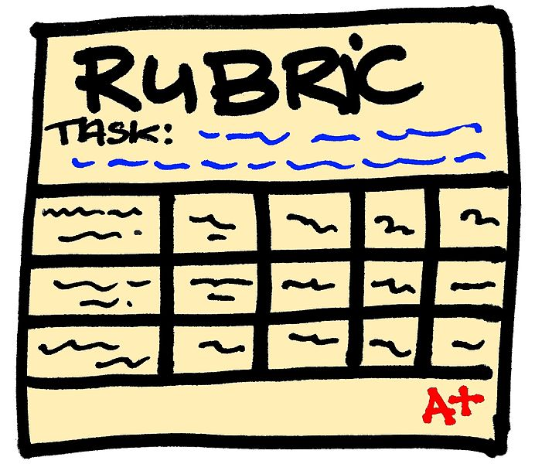
Assessment Rubric
MLP Model (RapidMiner out of 50%)
Report quality 15%
Construction of MLP in selected language 45%
Epochs vs Bad Facts 10%
Experiments with more hidden neurons and different Error Threshold and Learning Rate values 15%
Documentation (scope, depth, completeness) 15%
Coursework
2022-23
ICT

Slide 8


Help & Contact Hour
Coursework
2022-23
If you get stuck ask for a contact hour.
This is strictly for problems of an academic nature.
My email is john.abela@um.edu.mt
In emergencies my mobile is 79367936. Please text before calling.
Please note that I normally cannot do debugging.
ICT

